Slide 1

Smart Tool for Data Digitization
AI-Powered Cost Planning for Digital Transformation Initiatives
Group 7 Team Members
Purva Vijay Mugdiya
Usha Pavani Thopalle
Sahana Nagaraj Reddy
Vamsikrishna Perabathula
Chaitanya Vishnu Radhakrishna
Chen-Li Lee

Slide 2
Objective
Purpose: Streamline cost estimation for document digitization
Built for: City of Stockton
Core Capabilities:
Estimation of scanning, OCR, storage, manpower, licensing costs
Custom pricing & real-time cloud rates
User upload PDF summarization
Visual analytics and repo

Slide 3
Challenges
Manual budgeting is time-consuming and error-prone
Outdated or inconsistent cost inputs
No standardization across departments
Difficulty in justifying estimates to stakeholders or grantors

Slide 4
Solution
A Web-Based Application That Offers:
Automatic cost computation
Real-time & fallback pricing (AWS, GCP, Azure)
PDF uploads or manual input
Estimated cost and storage data visualizations & downloadable reports
PDF summarization and query based chatbot.

Slide 5
Key Business Benefits
Feature | Benefit
Automated Estimates | Saves time & improves accuracy
Standardized Process | Enables cross-department consistency
Custom Pricing Options | Adaptable to contracts & policies
Audit Trail | Enhances transparency & documentation
Visual Reports | Supports grant applications & stakeholder updates

Slide 6
How It Works – Overview
Upload or input document data
Application extracts metadata
Calculates costs: scanning, OCR, storage, manpower, software
Generates reports (CSV, PDF) & visualizations
User uploaded PDF summarization
Query based chatbot
Logs session history for reuse and auditing

Slide 7
Cost Components Explained
Scanning Rate × Pages
OCR Rate × Pages
Storage Cost = Size × Rate × Duration
Manpower = Effort Level × Pages
Licensing = Flat Rate per Provider (or) Custom License Rate

Slide 8
Future Enhancements
Role-based access control
Mobile-friendly interface
Multilingual support
Grant-ready reporting
Integration with procurement & document systems

Slide 9
Summary & Value Proposition
Why This Matters for the City of Stockton:
Consistent, data-backed budgeting
Faster digitization project approvals
Improved interdepartmental collaboration
Long-term cost tracking and insights
Reducing data loss

Slide 10
Thank you

Slide 11
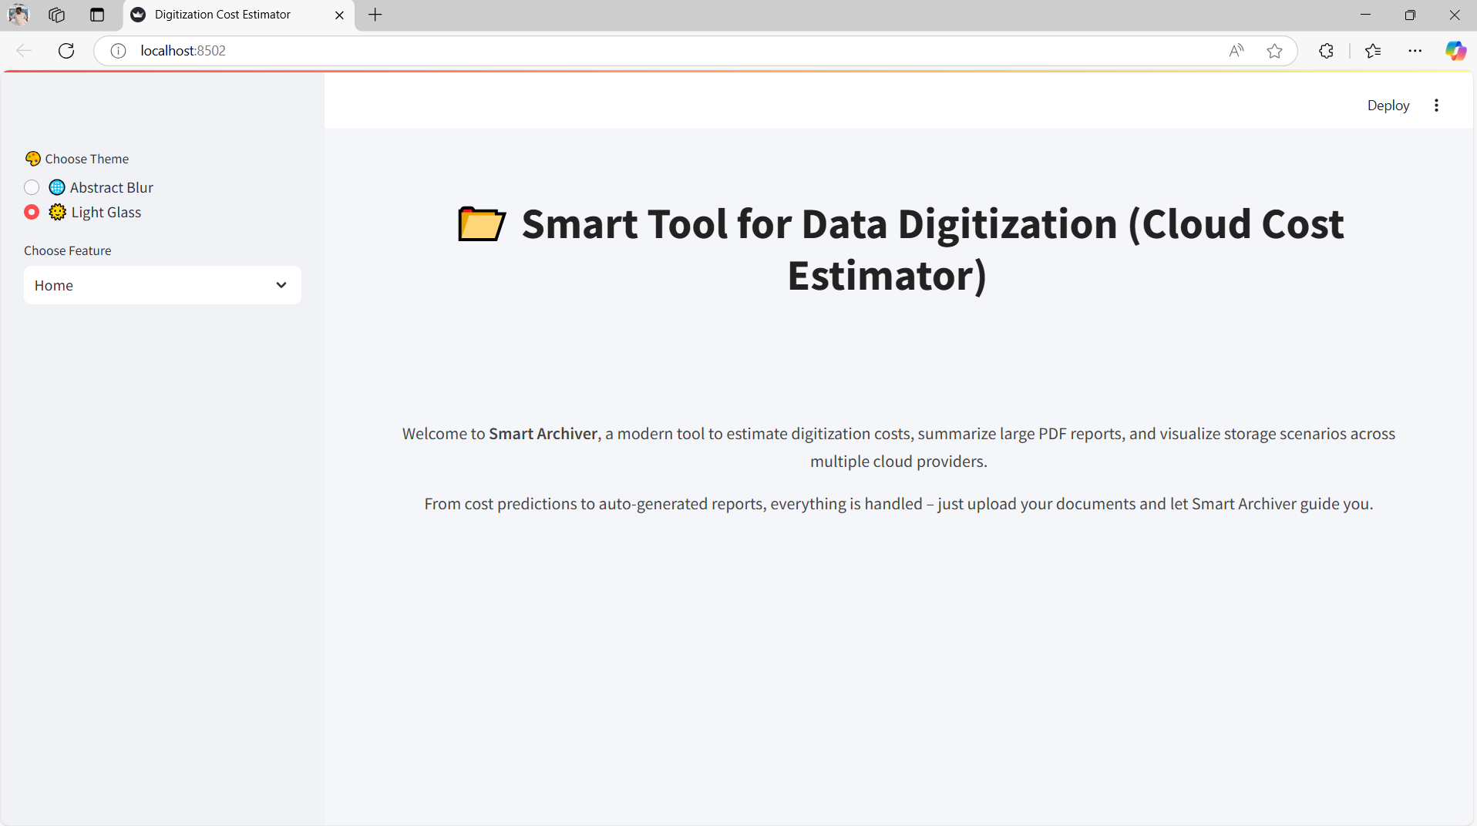
User Interface Snapshots
Fig 1: Home screen

Slide 12
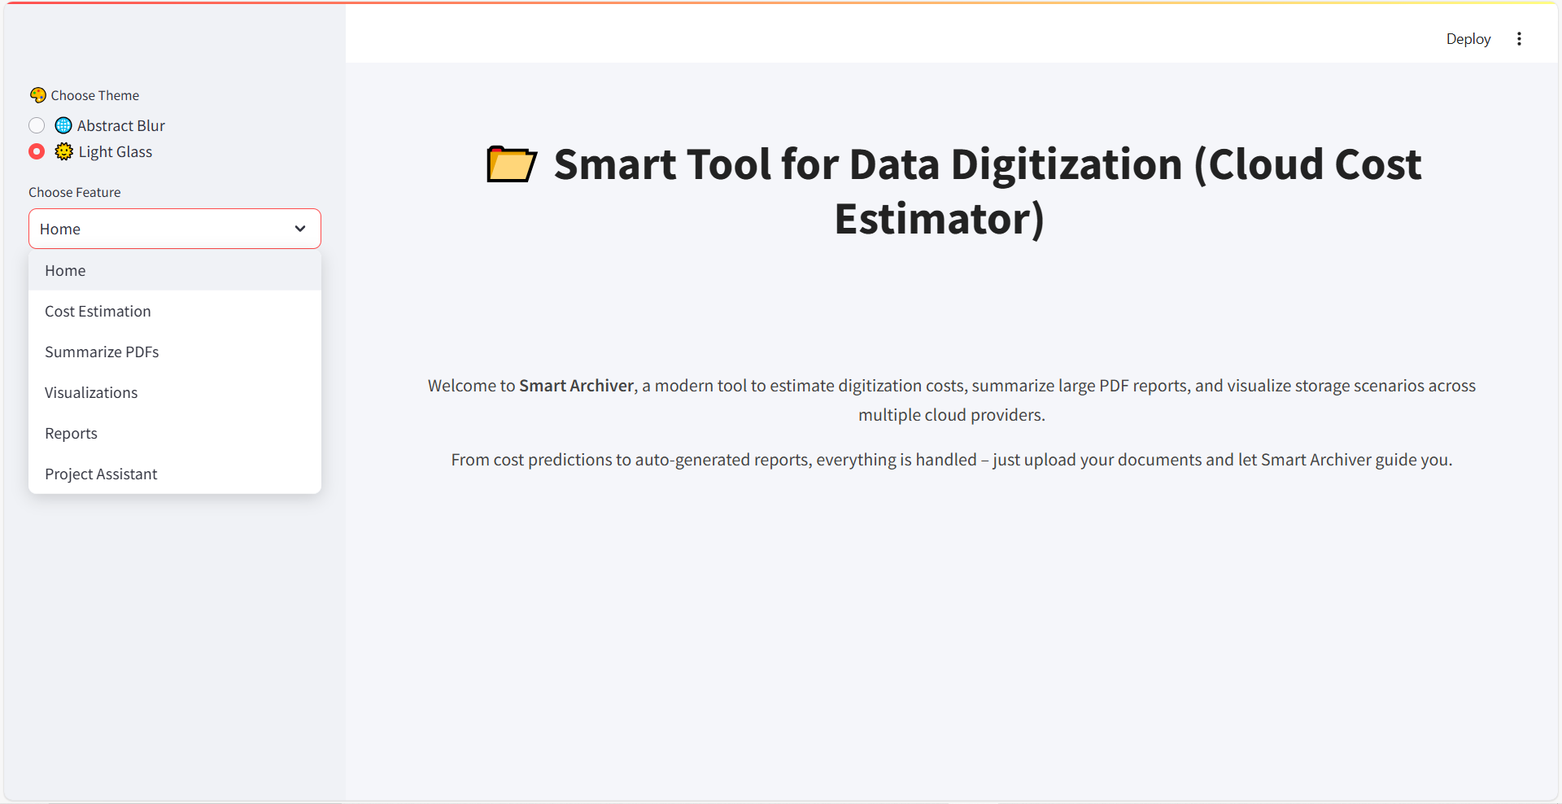
Fig 2: Key Features

Slide 13
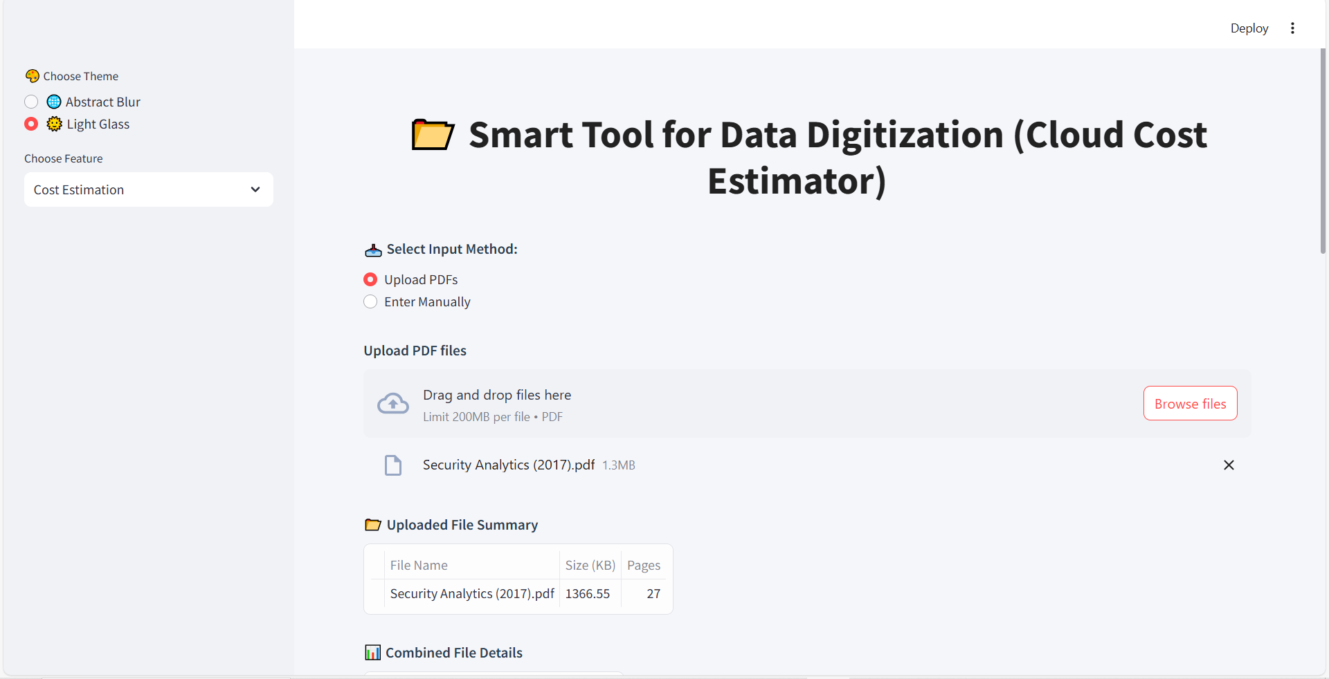
Fig 3: Cost Estimation

Slide 14
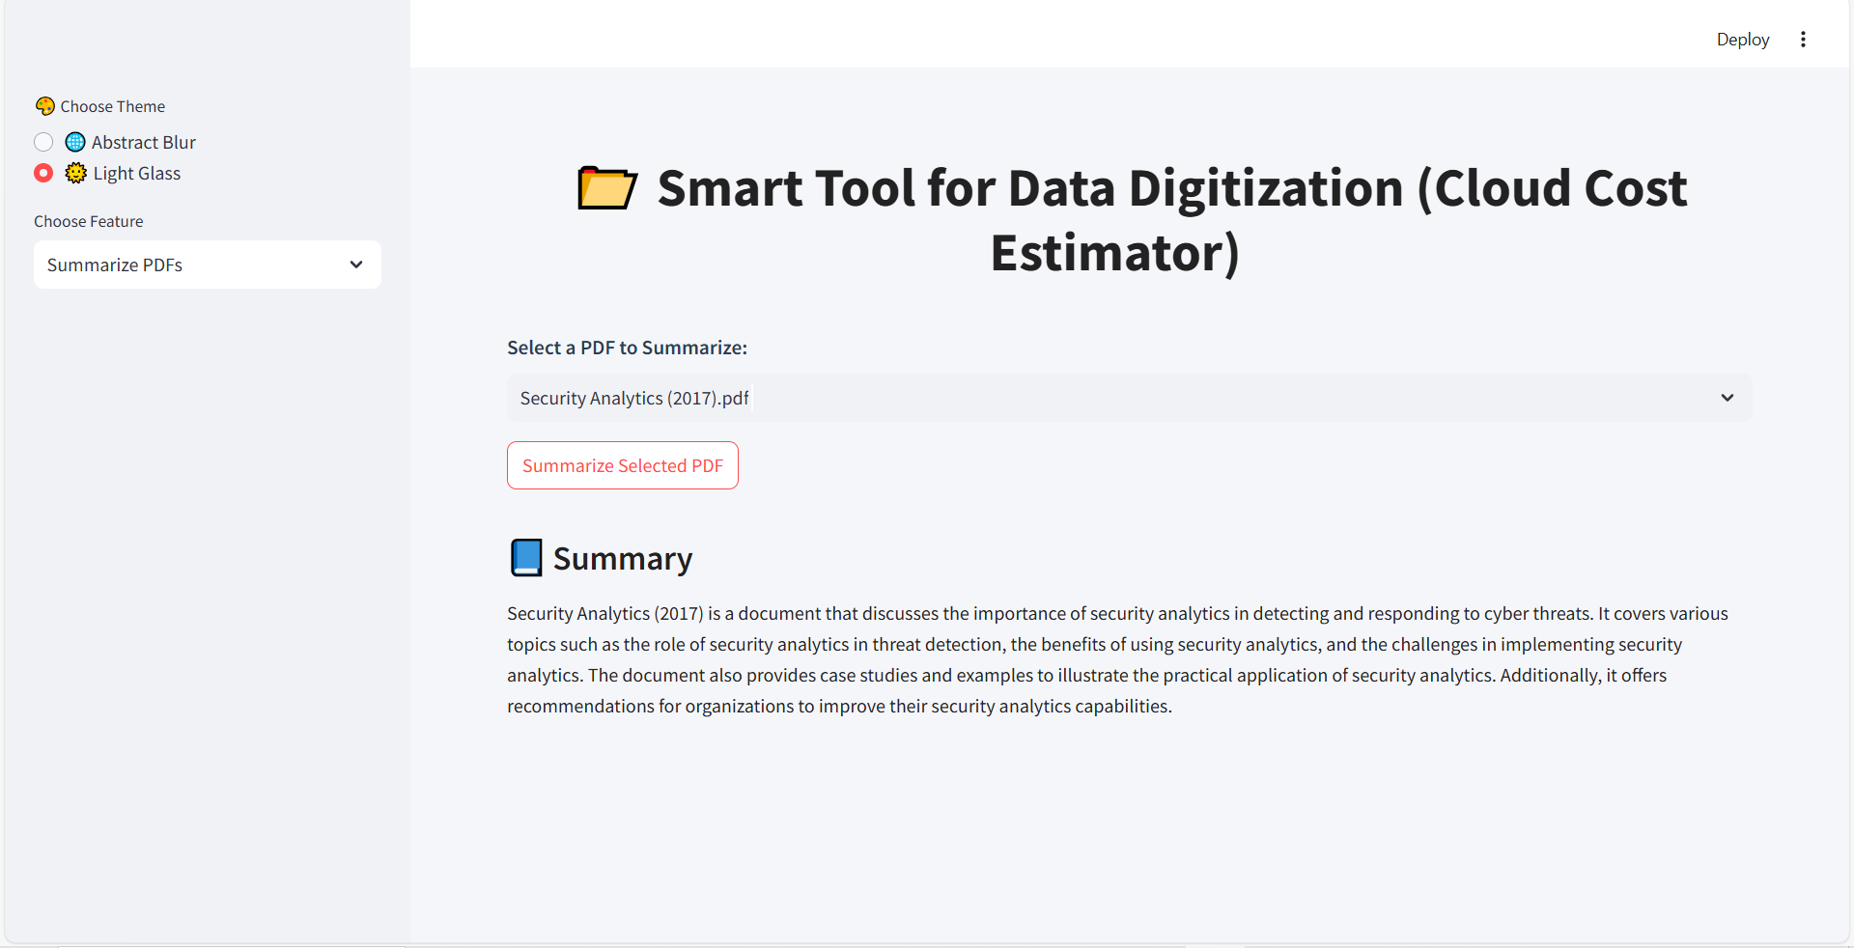
Fig 4: Summarize PDFs

Slide 15
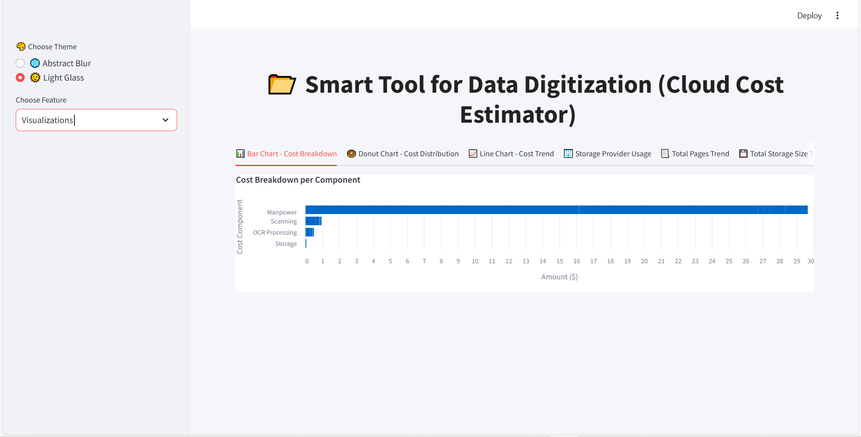
Fig 5: Visualization

Slide 16
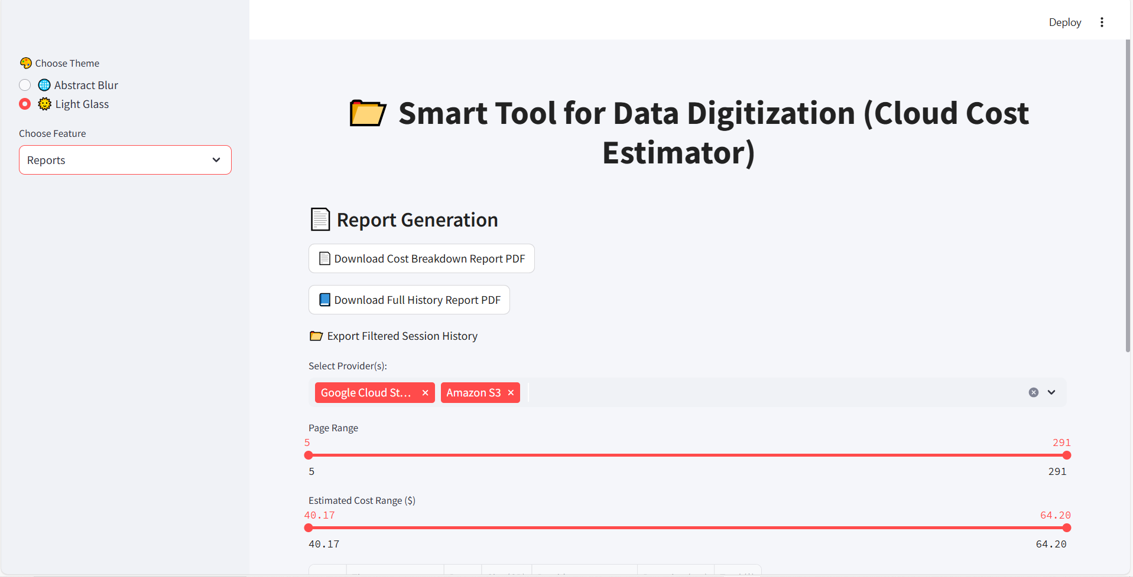
Fig 6: Reports

Slide 17
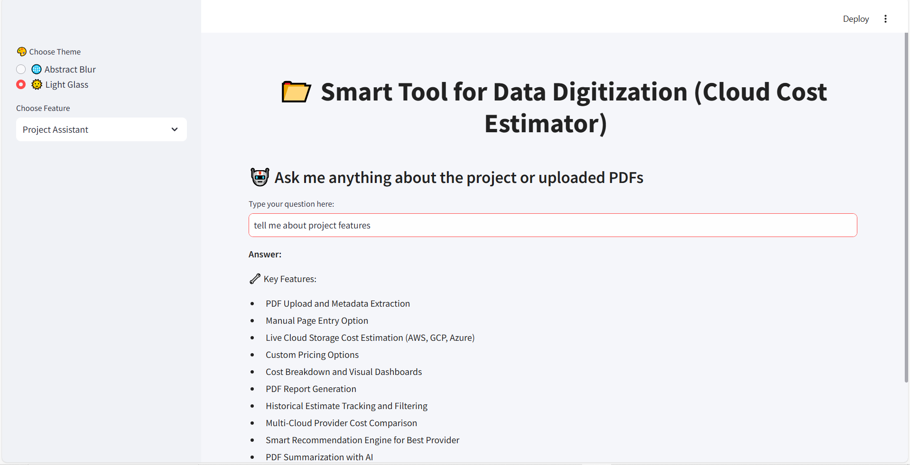
Fig 7: Project Assistant– Key Features

Slide 18
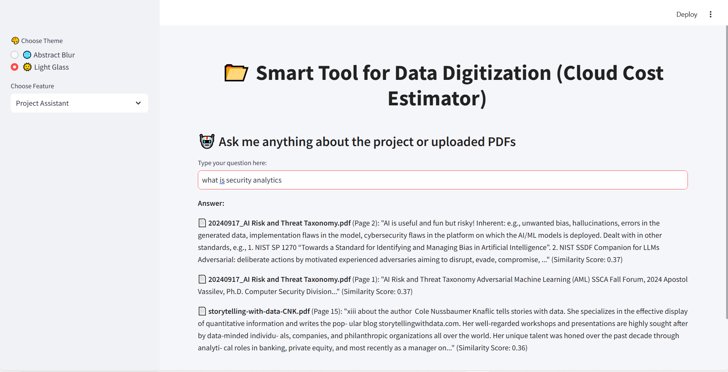
Fig 8: Project Assistant– Semantic Search

